Slide 1

Savitribai Phule Shikshan Prasarak Mandal’s N. B. Navale Sinhgad College of Engineering, Solapur Department of Computer Science & Engineering
Lab-I : Project Phase I Project Synopsis Review – II
“ Developing a software that can translate resource material and other texts from English to other Indian regional languages ”
Project Group No. 04
Presented By :
Mr. Mustafa Masuldar
Mrs. Sakshi Deshmukh
Mrs. Pooja Pawar
Mrs. Nandini Madre
Mrs. Maleka Iram Muchale
Under Guidance of
Prof. S.A. Dhanawe

Slide 2
Contents
Introduction
Literature Review
Problem Statement
Objective & Scope
Proposed Methodology
Conclusion
References

Slide 3
Abstract
CIPAM, dedicated to advancing Intellectual Property Rights (IPR) awareness, commercialization, and enforcement, has created extensive educational materials. The software aims to bridge linguistic gaps by translating these materials from English to key Indian regional languages: Hindi, Marathi, Bengali, Gujarati, Tamil, and Telugu.
The software's core features include its ability to translate various formats, such as Word documents, PDFs, and text within images. Notably, it focuses on maintaining the contextual integrity and professionalism of the original content, ensuring that translations are not only accurate but also accessible to the general public.
This abstract outlines a comprehensive approach involving Natural Language Processing (NLP) techniques, machine learning algorithms, and collaboration with experts to ensure the software's accuracy and user-friendliness.

Slide 4
Introduction
A software solution to translate intellectual property resource materials and texts from English to various Indian regional languages is a commendable initiative for promoting IPR awareness, commercialization, and enforcement. To achieve this objective effectively, the software should encompass the following key features :
Translation Capabilities: The software should have robust translation capabilities that can handle different formats such as Word documents, PDFs, and text within images. It should be able to extract text from these formats and translate it accurately.
Translation Accuracy: The translation should go beyond literal translations to capture the true meaning of the text. It should consider the context and nuances of the content to ensure accuracy.
Language Options: The software should support translation into a variety of Indian regional languages, as specified, including Hindi, Marathi, Bengali, Gujarati, Tamil, and Telugu. Users should be able to select their desired target language.
User-Friendly Interface: The software should have a user-friendly interface that allows users to easily upload their documents or text for translation and select their target language. It should also provide options for customization.
Resource Materials Accessibility: Ensure that the translated materials are accessible and available for download or distribution, so that they can reach the intended audiences efficiently.
Scalability: Design the software to be scalable to accommodate a growing user base and increased demand for translation services.

Slide 5

Literature Review
Title: Dual Translation of International and Indian Regional Language using Recent Machine Translation
Title: Machine Translation Approaches and Survey for Indian Languages
Title: Tackling Multiway Translation of Indian Languages
Title: Machine Translation of English Videos to Indian Regional Languages using Open Innovation
Title: Translation Across Cultures: From The Regional To The Universal
Title: A Review of Terminological Work Being Done in Indian Languages
Title: Study on Machine Translation Approaches for Indian Languages and Their Challenges
Title: Automated Conversion of English and Hindi Text to Braille Representation
Title: Study of Machine Translation Systems and Techniques for Indian Languages
Title: Machine Translation Development For Indian Languages And Its Approaches
Research papers : https://drive.google.com/drive/folders/1ZwulcEIcZVzt9p8-eFw194DCzRvXS0v9?usp=sharing

Slide 6
Problem Statement
CIPAM seeks software for precise translation of IPR resource materials from English to Indian regional languages (Hindi, Marathi, Bengali, Gujarati, Tamil, Telugu) in various formats.

Slide 7
Objectives and Scope
Objective:
To develop software that enables accurate translation of IPR resource materials from English to Indian regional languages (Hindi, Marathi, Bengali, Gujarati, Tamil, Telugu) across various formats, ensuring the preservation of the text's intended meaning.
Scope:
The software will cover translation needs for a range of resource materials, such as Word documents, PDFs, and text within images. It will focus on providing translations that capture the context and true essence of the content, rather than just literal translations, for the specified Indian regional languages.

Slide 8
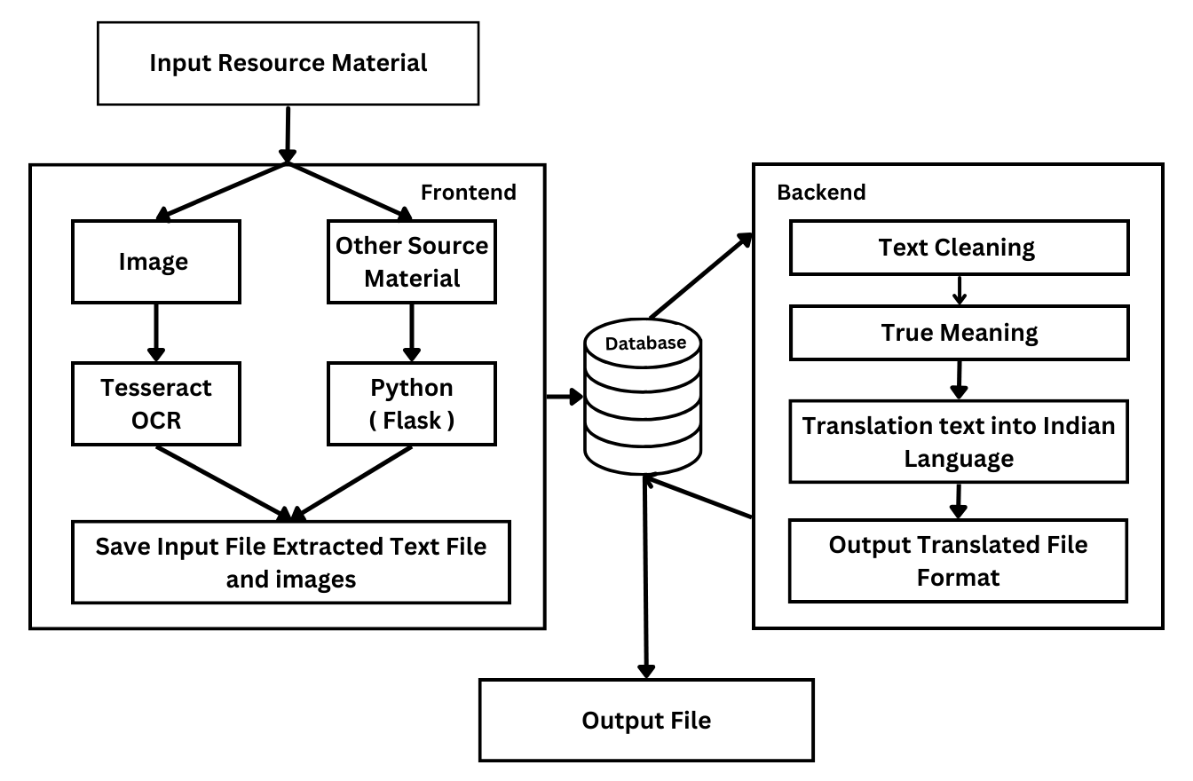
Proposed Methodology

Slide 9
Conclusion
By implementing the recommended features and considerations outlined in the previous response, this software can become a valuable resource for students, industries, the general public, police, judiciary, and customs officials. It will facilitate not only the translation of content but also the dissemination of knowledge in a manner that is both accurate and easy to understand.

Slide 10
References
Title: “ Machine Translation System in Indian Perspectives "
Authors: Sanjay K Dwivedi, Pramod Sukhadeve
Link: https://www.researchgate.net/publication/47554517_Machine_Translation_System_in_Indian_Perspectives
Title: "Machine Translation Approaches and Survey for Indian Languages "
Authors: Antony P. J.
Link: https://aclanthology.org/O13-2003.pdf
Summary: This review paper gives an overview of the state of English to Indian language machine translation, discussing various techniques and challenges.
Title: "Machine Translation Approaches and Survey for Indian Languages"
Authors: Nadeem Jadoon Khan, Waqas Anwar, Nadir Durrani
Link: https://arxiv.org/ftp/arxiv/papers/1701/1701.04290.pdf
Summary: This paper provides an in-depth review of the challenges in machine translation from English to Indian languages, which can help you understand the complexities involved in your software project.

Slide 11
Savitribai Phule Shikshan Prasarak Mandal’s N. B. Navale Sinhgad College of Engineering, Solapur Department of Computer Science & Engineering
Thank You

